Slide 1

Speaking
Imagine that you are preparing for your trip down the Mekong . What would you take?
1.Look at the following things in the picture.
Choose five that you think are the most useful.
2. Compare your list with your partner. Give your reasons why you choose them.

Slide 2
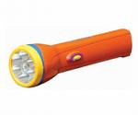
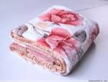

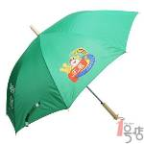

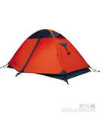
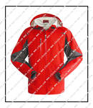
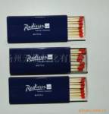
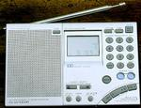
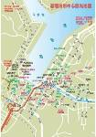
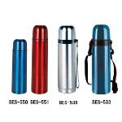
flashlight
blanket
can and bottle openers
tent
coat
umbrella
compass
match
water bottle
radio
map

Slide 3

A NIGHT IN THE MOUNTAINS

Slide 4

What items are Wang Kun and WangWei carrying with them?
What do you think they will have to leave behind in Dali?
What should they take instead?

Slide 5

From this passage you have learned
Useful words:_____________________
Use expressions:___________________

Slide 6
From this passage you have learned
Useful words: reliable, view, company
Use expressions: see sb. do, be dressed in, as usual, find sb. doing, make camp, put up, at midnight, for company

Slide 7
Language points
Have you ever seen snowmen ride bicycle？
see sb. do sth. : “看见某人做某事”

Slide 8
【辨析】see sb. do, see sb. doing和see sth. done
1) see sb. do 表示看见一个动作的全过程；
e.g.
I ___ ___ ___ the key in the lock， turn it and open the door.
我看见他把钥匙插进锁孔，转动钥匙，然后打开了门。

Slide 9
【辨析】see sb. do, see sb. doing和see sth. done
2) see sb. doing 表示看见一个动作正在进行
e.g.
I ___ ___ ____ in the office.
我看见他在办公室抽烟。

Slide 10
【辨析】see sb. do, see sb. doing和see sth./sb. done
3) see sth. done 表示看见被动的动作。
e.g.
He hated to see any bird killed.

Slide 11
即学即练
根据汉语，完成句子。
1)昨天，我看见她在操场上打篮球。
When I passed the playground, I ________________________ there.
2) 回家时，我看见我的衣服被洗了。
When I came back home, I __________________________________.
saw her playing basketball
saw my clothes washed

Slide 12
Language points
At one point we were so high that we found ourselves cycling through clouds.
find sb. doing. : “发现某人正处于某种状态”
The next morning the man was found_____(lie) on the floor.

Slide 13
Language points
At one point we were so high that we found ourselves cycling through clouds.
find sb. doing. : “发现某人正处于某种状态”

Slide 14
Language points
There was almost no wind--only the flames of our fire for company.
for company: “作为陪伴”
我喜欢和她在一起.
I enjoy _____ _____.

Slide 15

Thanks for your listening!

